Slide 1

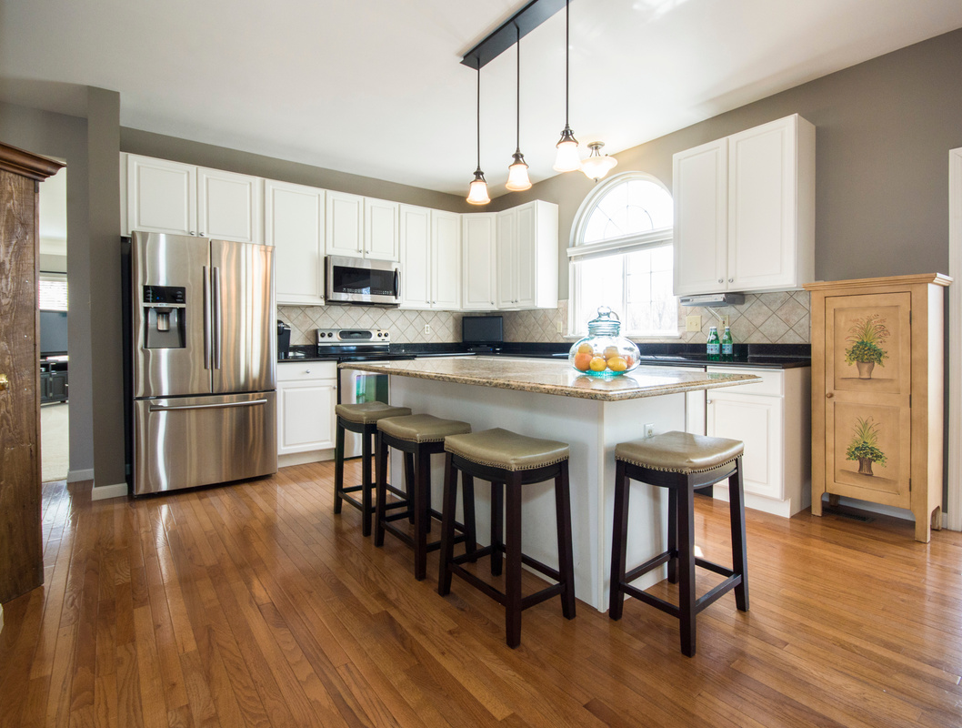

Real Estate Data Management and Analysis
01

Slide 2

2
ABSTRACT
This MySQL project explores real estate data to identify trends in pricing, demand, and investment opportunities. By leveraging SQL queries, subqueries, and aggregate functions, it extracts valuable insights from property listings, including location, size, and amenities. Data visualization enhances interpretation, helping buyers, sellers, and investors make informed decisions based on market patterns.

Slide 3
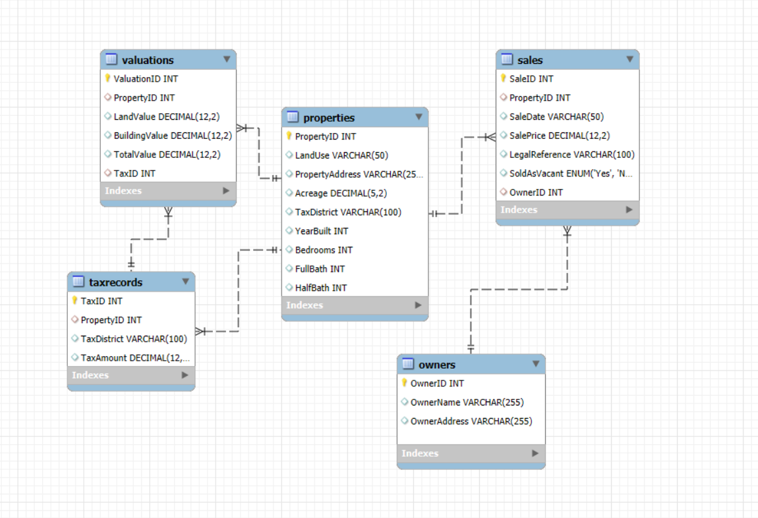
ER DIAGRAM
3
03

Slide 4
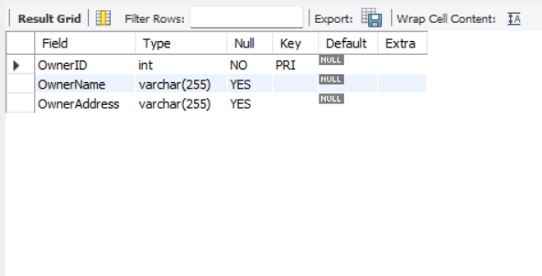
STRUCTURE OF TABLE
4
Owner Table
This table Stores details of property owners, including their name and address. Helps track who owns each property.
Syntax : Desc Owners;

Slide 5
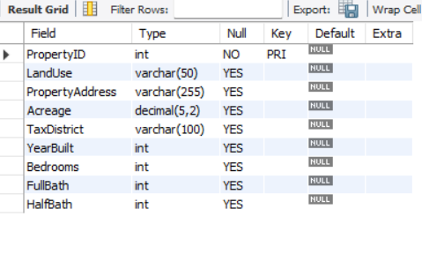
STRUCTURE OF TABLE
5
Properties Table
This table Contains information about properties like location, size, and number of rooms. Used for listing and managing real estate.
Syntax : Desc Properties ;

Slide 6
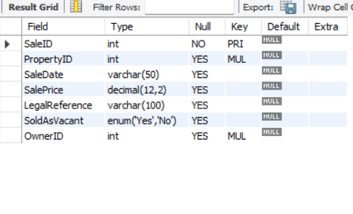
STRUCTURE OF TABLE
6
Sales Table
This table Keeps records of property sales, including sale date and price. Useful for tracking transaction history.
Syntax : Desc Sales;

Slide 7
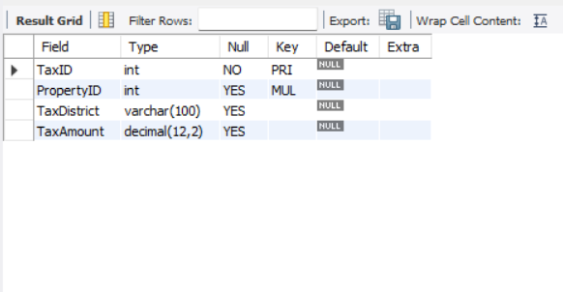
STRUCTURE OF TABLE
7
TaxRecords Table
This table Maintains tax details of properties, including tax amount and district. Helps in managing property taxes.
Syntax : Desc TaxRecords;

Slide 8
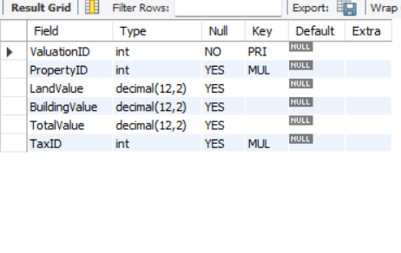
STRUCTURE OF TABLE
8
Valuations Table
This table Stores property valuation details, including land value and total worth. Helps in assessing property prices.
Syntax : Desc Valuations ;

Slide 9
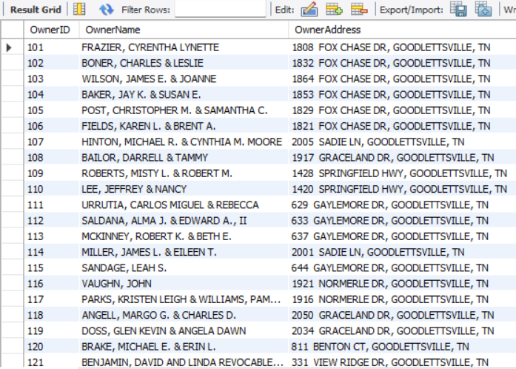
CONTENTS OF TABLE
13
9
Select * from Owners

Slide 10
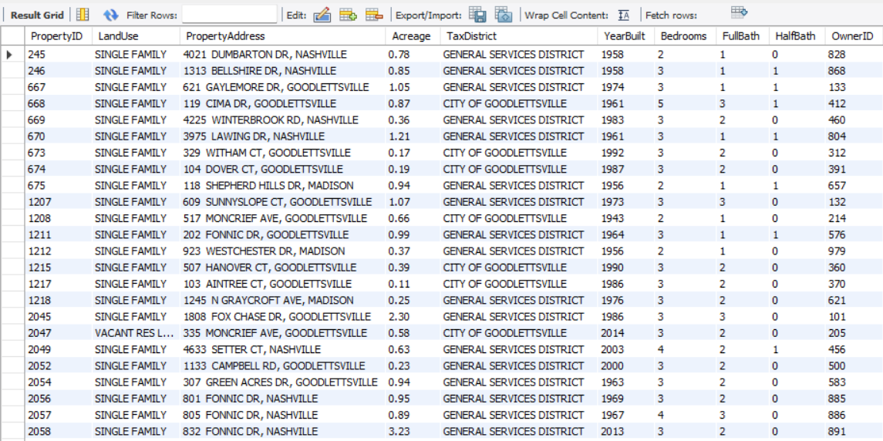
CONTENTS OF TABLE
10
Select * from Properties

Slide 11
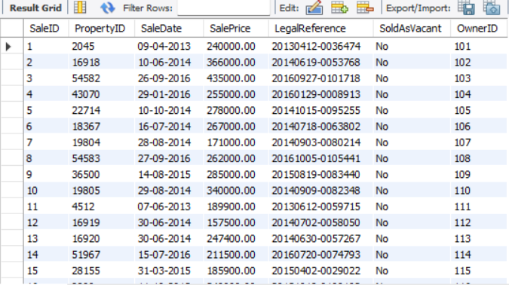
CONTENTS OF TABLE
11
Select * from Sales

Slide 12
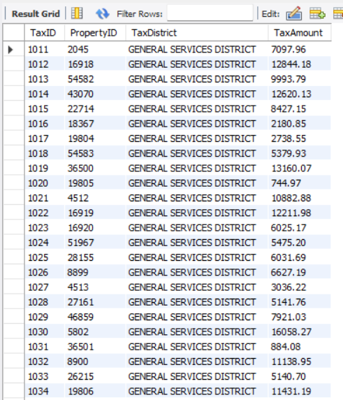
CONTENTS OF TABLE
12
Select * from TaxRecords

Slide 13
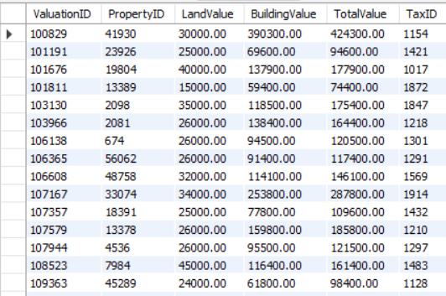
CONTENTS OF TABLE
13
Select * from Valuation

Slide 14

SUB QUERIES

Slide 15
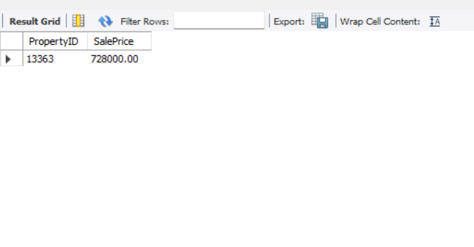
SUB QUERIES
15
Find Properties with the Highest
Sale Price
Syntax : SELECT PropertyID, SalePrice
FROM Sales
WHERE SalePrice = (SELECT MAX(SalePrice) FROM Sales);

Slide 16
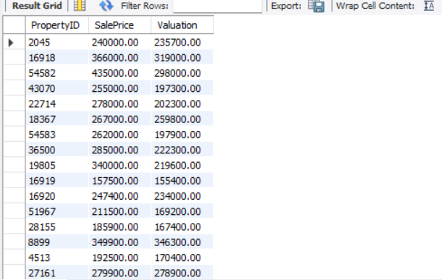
SUB QUERIES
16
Find Properties Sold Above Their Valuation
Syntax : SELECT PropertyID, SalePrice,
(SELECT TotalValue FROM Valuations V WHERE V.PropertyID = S.PropertyID) AS Valuation
FROM Sales S
WHERE SalePrice > (SELECT TotalValue FROM Valuations V WHERE V.PropertyID = S.PropertyID);

Slide 17
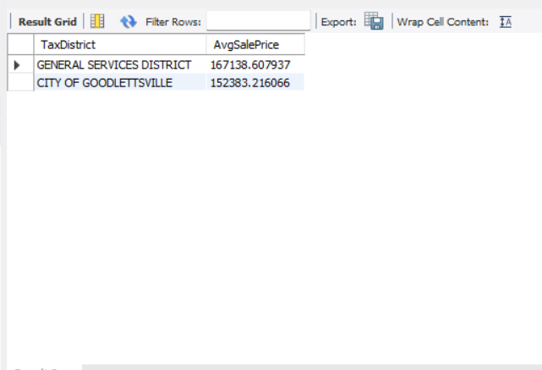
SUB QUERIES
17
Find the Average Sale Price for Each Tax District
Syntax : SELECT TaxDistrict,
(SELECT AVG(SalePrice)
FROM Sales S
JOIN Properties P ON S.PropertyID =
P.PropertyID
WHERE P.TaxDistrict = T.TaxDistrict) AS AvgSalePrice
FROM TaxRecords T
GROUP BY TaxDistrict;

Slide 18
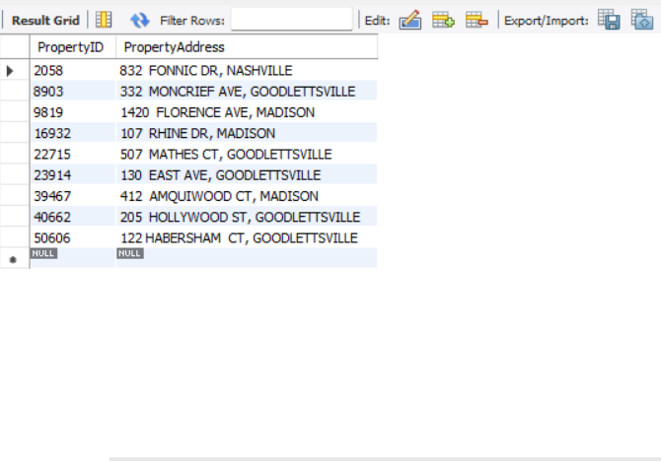
SUB QUERIES
18
Find Properties Without Any Sales Record
Syntax : SELECT PropertyID, PropertyAddress
FROM Properties
WHERE PropertyID NOT IN (SELECT PropertyID FROM Sales);

Slide 19
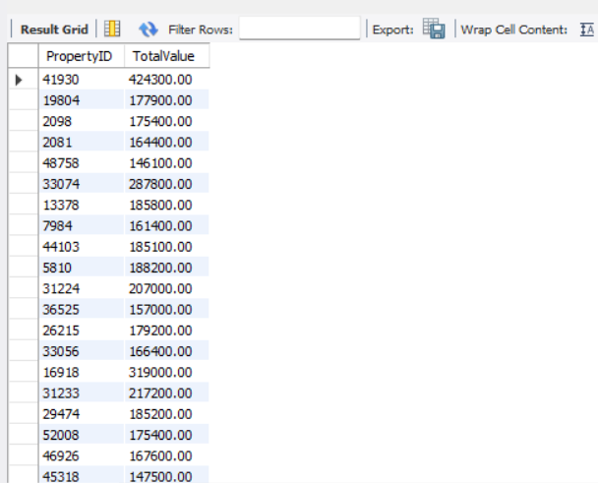
SUB QUERIES
19
Find Properties That Have a Higher Total Value Than the Average Total Value
Syntax : SELECT PropertyID, TotalValue
FROM Valuations
WHERE TotalValue > (SELECT AVG(TotalValue) FROM Valuations);

Slide 20

JOINS

Slide 21
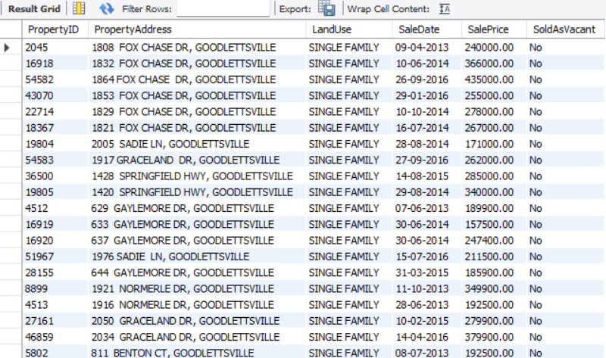
JOINS
20
Get All Property Details Along with Sale Information
Syntax : SELECT P.PropertyID, P.PropertyAddress, P.LandUse, S.SaleDate, S.SalePrice, S.SoldAsVacant
FROM Properties P
JOIN Sales S ON P.PropertyID = S.PropertyID;

Slide 22
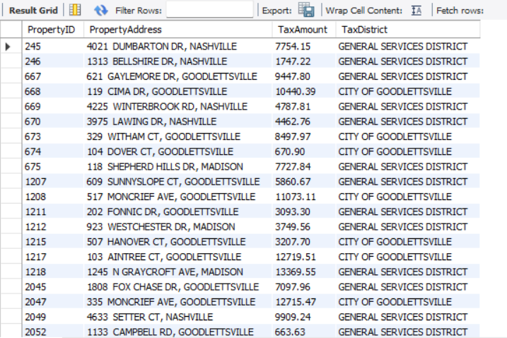
JOINS
21
Find Properties Without Any Sales Record
Syntax : SELECT P.PropertyID, P.PropertyAddress, T.TaxAmount, T.TaxDistrict
FROM Properties P
LEFT JOIN TaxRecords T ON P.PropertyID = T.PropertyID;

Slide 23
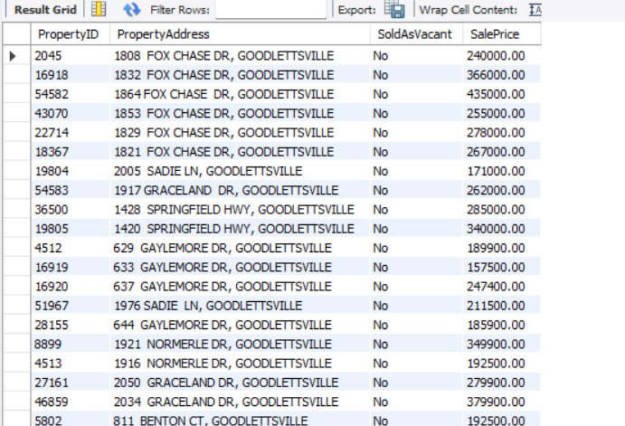
JOINS
22
Get Properties Sold as Vacant vs Occupied
Syntax : SELECT P.PropertyID, P.PropertyAddress, S.SoldAsVacant, S.SalePrice
FROM Properties P
JOIN Sales S ON P.PropertyID = S.PropertyID
ORDER BY S.SoldAsVacant DESC;

Slide 24
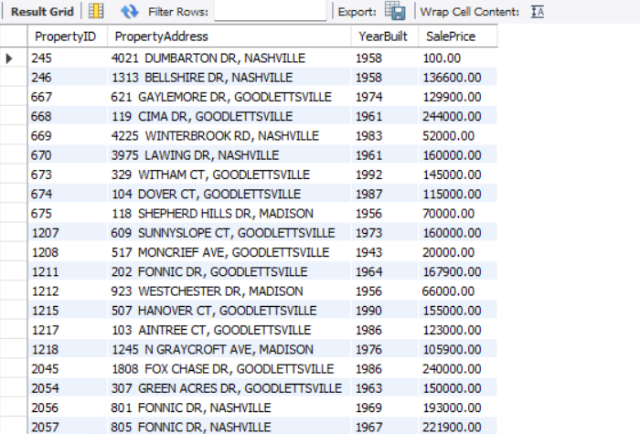
JOINS
23
Get Properties Built Before 2000 That Have Been Sold
Syntax : SELECT P.PropertyID, P.PropertyAddress, P.YearBuilt, S.SalePrice
FROM Properties P
JOIN Sales S ON P.PropertyID = S.PropertyID
WHERE P.YearBuilt < 2000;

Slide 25

VIEWS

Slide 26
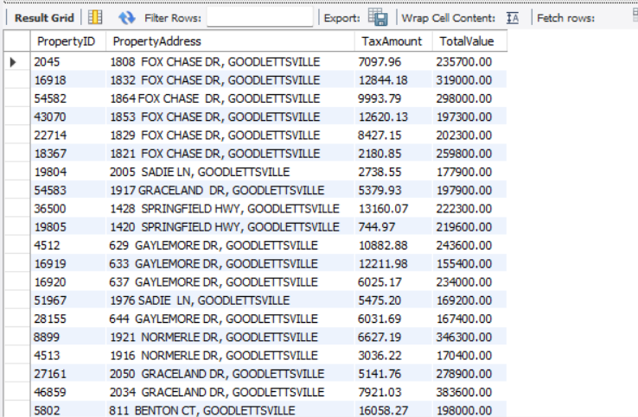
VIEW
24
View for Tax and Valuation Comparison
Syntax : SELECT T.PropertyID, P.PropertyAddress, T.TaxAmount, V.TotalValue
FROM TaxRecords T
JOIN Valuations V ON T.PropertyID = V.PropertyID
JOIN Properties P ON T.PropertyID = P.PropertyID;

Slide 27
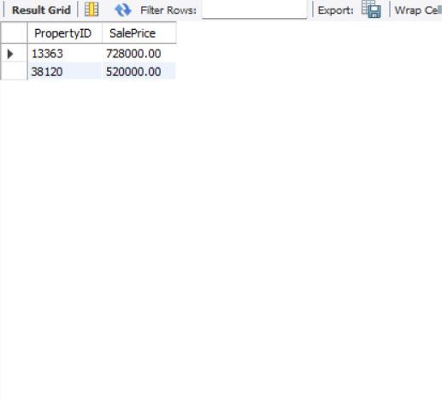
VIEW
25
View to Show High-Value Properties
Syntax : CREATE VIEW ExpensiveProperties AS
SELECT PropertyID, SalePrice
FROM sales
WHERE SalePrice > 500000;

Slide 28

PREPARED BY :
MAYURI AWARE
IT VEDANT
T334/17thMar/3pm-5pm/Prachiti mam/R

Slide 29

THANK YOU

